Slide 1

TELECOMMUNICATION SYSTEM NETWORK
Presented BY:
MD ARAFAT SIRAJ
ID: 0222220005101030
PRIYAM SHARMA
ID: 0222220005101018
ABIR AHAMED OMI
ID: 0222220005101021
PREMIER UNIVERSITY CHATTOGRAM
DEPARTMENT OF COMPUTER SCIENCE AND ENGINEERING
SESSION:- SPRING-2025
BATCH-42
SECTION:-A
COURSE:- Computer Networks Lab [CSE-3568]

Slide 2
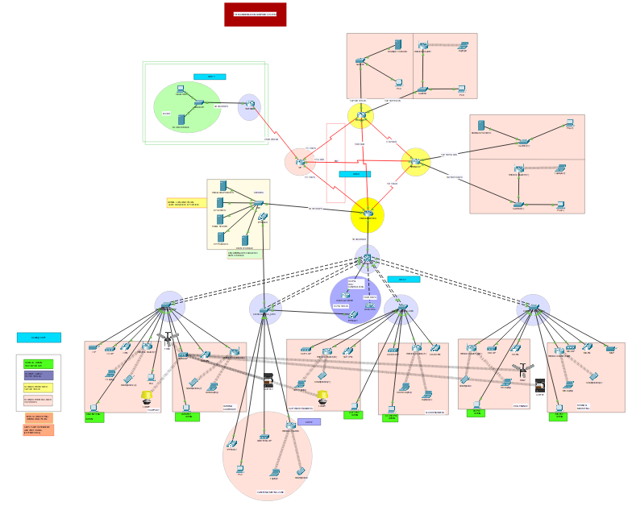
Abstract
Complete Enterprise-level Network
Connectivity: Headquarters, Branches , ISP and INTERNET.
Services: DHCP, DNS, HTTP, Email, IoT, VoIP.

Slide 3
Introduction
Purpose: Secure enterprise telecommunication system
Sites: Headquarters, Branch 1, Branch 2, ISP & INTERNET.
Centralized servers & VLANs

Slide 4
Problem Statement
Multi-site connectivity (Headquarters, Branch1, Branch2, ISP, INTERNET)
Centralized services needed
VLAN isolation required
Secure IoT & VoIP integration
Guest internet access without internal access

Slide 5
Requirements
VLANs (Admin, Guest, LAN, WLAN, VoIP)
DHCP, DNS, HTTP, Email servers
OSPF Routing
ACLs for Security
NAT/PAT for Internet

Slide 6
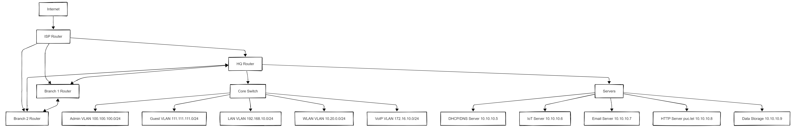
LOGICAL Design

Slide 7
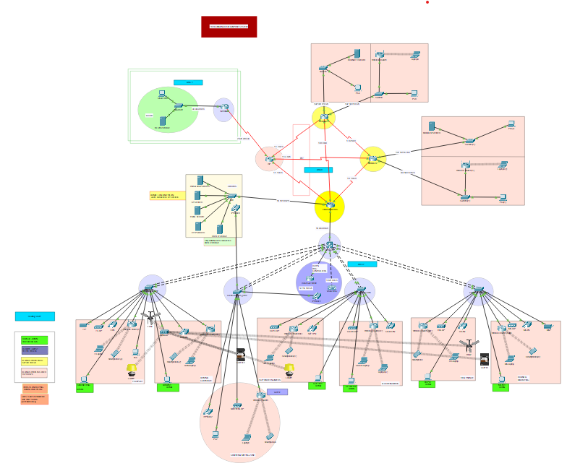
Physical design

Slide 8
Implementation
Subnet # | Network Address | First Usable IP | Last Usable IP | Broadcast Address | Subnet Mask | Prefix
1 | 30.30.30.0 | 30.30.30.1 | 30.30.30.254 | 30.30.30.255 | 255.255.255.0 | /24
2 | 20.20.20.0 | 20.20.20.1 | 20.20.20.2 | 20.20.20.3 | 255.255.255.252 | /30
3 | 10.10.10.0 | 10.10.10.1 | 10.10.10.14 | 10.10.10.15 | 255.255.255.240 | /28
4 | 1.1.1.0 | 1.1.1.1 | 1.1.1.254 | 1.1.1.255 | 255.255.255.0 | /24
5 | 1.1.2.0 | 1.1.2.1 | 1.1.2.254 | 1.1.2.255 | 255.255.255.0 | /24
6 | 1.1.3.0 | 1.1.3.1 | 1.1.3.254 | 1.1.3.255 | 255.255.255.0 | /24
7 | 10.30.30.0 | 10.30.30.1 | 10.30.30.2 | 10.30.30.3 | 255.255.255.252 | /30
8 | 1.0.0.0 | 1.0.0.1 | 1.0.0.2 | 1.0.0.3 | 255.255.255.252 | /30
9 | 1.0.1.0 | 1.0.1.1 | 1.0.1.2 | 1.0.1.3 | 255.255.255.252 | /30
10 | 1.0.2.0 | 1.0.2.1 | 1.0.2.2 | 1.0.2.3 | 255.255.255.252 | /30
11 | 192.168.10.0 | 192.168.10.1 | 192.168.10.254 | 192.168.10.255 | 255.255.255.0 | /24
12 | 192.168.11.0 | 192.168.11.1 | 192.168.11.254 | 192.168.11.255 | 255.255.255.0 | /24
13 | 192.168.12.0 | 192.168.12.1 | 192.168.12.254 | 192.168.12.255 | 255.255.255.0 | /24
14 | 192.168.13.0 | 192.168.13.1 | 192.168.13.254 | 192.168.13.255 | 255.255.255.0 | /24
15 | 192.168.14.0 | 192.168.14.1 | 192.168.14.254 | 192.168.14.255 | 255.255.255.0 | /24
16 | 111.111.111.0 | 111.111.111.1 | 111.111.111.254 | 111.111.111.255 | 255.255.255.0 | /24
17 | 100.100.100.0 | 100.100.100.1 | 100.100.100.254 | 111.111.111.255 | 255.255.255.0 | /24
18 | 10.20.0.0 | 10.20.0.1 | 10.20.0.254 | 10.20.0.255 | 255.255.255.0 | /24
19 | 172.16.10.0 | 171.16.10.1 | 172.16.10.254 | 172.16.10.255 | 255.255.255.0 | /24
Device | Interface | IP Address | Subnet Mask
INERNET | Gig0/0 | 30.30.30.1 | 255.255.255.0
INTERNET | Se0/3/0 | 20.20.20.1 | 255.255.255.252
ISP | Se0/3/0 | 20.20.20.2 | 255.255.255.252
ISP | Se0/3/1 | 1.1.1.1 | 255.255.255.0
ISP | Se0/2/0 | 1.1.2.1 | 255.255.255.0
ISP | Se0/2/1 | 1.1.3.1 | 255.255.255.0
BRANCH 1 | Se0/2/0 | 1.1.2.2 | 255.255.255.252
BRANCH 1 | Se0/3/0 | 1.0.0.2 | 255.255.255.252
BRANCH 1 | Se0/2/1 | 1.0.2.1 | 255.255.255.252
BRANCH 1 | Gig0/0 | 192.168.11.1 | 255.255.255.0
BRANCH 1 | Gig0/1 | 192.168.12.1 | 255.255.255.0
BRANCH 2 | Se0/3/0 | 1.1.3.2 | 255.255.255.252
BRANCH 2 | Se0/2/0 | 1.0.1.2 | 255.255.255.252
BRANCH 2 | Se0/2/1 | 1.0.2.2 | 255.255.255.252
BRANCH 2 | Gig0/0 | 192.168.13.1 | 255.255.255.0
BRANCH 2 | Gig0/1 | 192.168.14.1 | 255.255.255.0
HEADQUARTERS | Se0/3/1 | 1.1.1.2 | 255.255.255.252
HEADQUARTERS | Se0/3/0 | 1.0.0.1 | 255.255.255.252
HEADQUARTERS | Se0/2/0 | 1.0.1.1 | 255.255.255.252
HEADQUARTERS | Gig0/0 | 10.30.30.1 | 255.255.255.252
HEADQUARTERS | Gig0/1 | 10.10.10.1 | 255.255.255.240
CORE SWITCH | Gig1/0/1 | 10.30.30.2 | 255.255.255.252
CORE SWITCH | VLAN 99(ADMIN) | 100.100.100.1 | 255.255.255.0
CORE SWITCH | VLAN 11(Guest) | 111.111.111.1 | 255.255.255.0
CORE SWITCH | VLAN 50(LAN) | 192.168.10.1 | 255.255.255.0
CORE SWITCH | VLAN 60(WLAN) | 10.20.0.1 | 255.255.255.0
VOICE GATEWAY | Fa0/0.101 (VLAN 101-VoIP) | 172.16.10.1 | 255.255.255.0
Subnetting &
IP allocation

Slide 9
implementation
DHCP
automatic IPs
ROUTING
OSPF Dynamic Routing
HTTP
PUC TELCO website
VLANS
VLAN 99: Admin
VLAN 11: Guest
VLAN 50: LAN
VLAN 60: WLAN
VLAN 101: VoIP
IoT
Wireless IoT via LAP
Remote control via IoT server
ACLs
IoT: Only Admin, LAN, WLAN
DATA STORAGE: Only Admin
Guest: Internet only
NAT/PAT
PAT at Headquartes, Branch 1 & 2 routes while gointg to ISP router.
VoIP
Numbers 111 to 120
For Headquarters internal Calling.

Slide 10
RESULTS
Full Connectivity
Secured Access Control
Services Integration
IoT & VoIP Integrated
NAT: PAT
✅

Slide 11
Discussions
Issues faced:
IP conflicts during subnetting
ACL misconfiguration blocking services
DNS resolution delays in Packet Tracer
Alternatives:
Routing: OSPF (used), RIP (simpler but less scalable)
NAT: PAT (used), Static NAT (precise but wastes IPs)
Simulation: Packet Tracer (used), real devices (more realistic)
Advantages: Scalable, secure with ACLs, cost-effective with Packet Tracer
Disadvantages: Limited simulator features, no real QoS or latency testing

Slide 12
Recommendations
Implement IPv6
Add Firewalls
Expand IoT surveillance

Slide 13
Conclusion
Robust enterprise network successfully designed
Integrated services: DHCP, DNS, HTTP, Email, IoT, VoIP
Secure with VLANs, ACLs, NAT/PAT
Scalable and future-proof
Met all project requirements

Slide 14
THANK YOU

